Slide 1
Faculty of Arts
Exchange Students – spring 2021

Slide 2
Important
Teaching period starts on February 15
What you should know by the end of orientation week!
your Palacký University email address + login (during orientation week)
your Palacký University portal login (what IS/STAG and MOODLE is)
course timetable
links to join lectures which you are enroled in - provided by teachers, they use Moodle or student university mail box). CONTACT the teacher if there is no message in your university mail box from him/her (check spam please), nor information in Moodle.

Slide 3
Palacký University STudy AGenda (STAG)
Information system used for study administration.
Portal STAG is a site where all necessary information about your study is available - courses, lecturers, course timetable etc.
Portal STAG has a public and nonpublic part. Nonpublic part requires login.
You should get login details information during the orientation week at the latest.

Slide 4
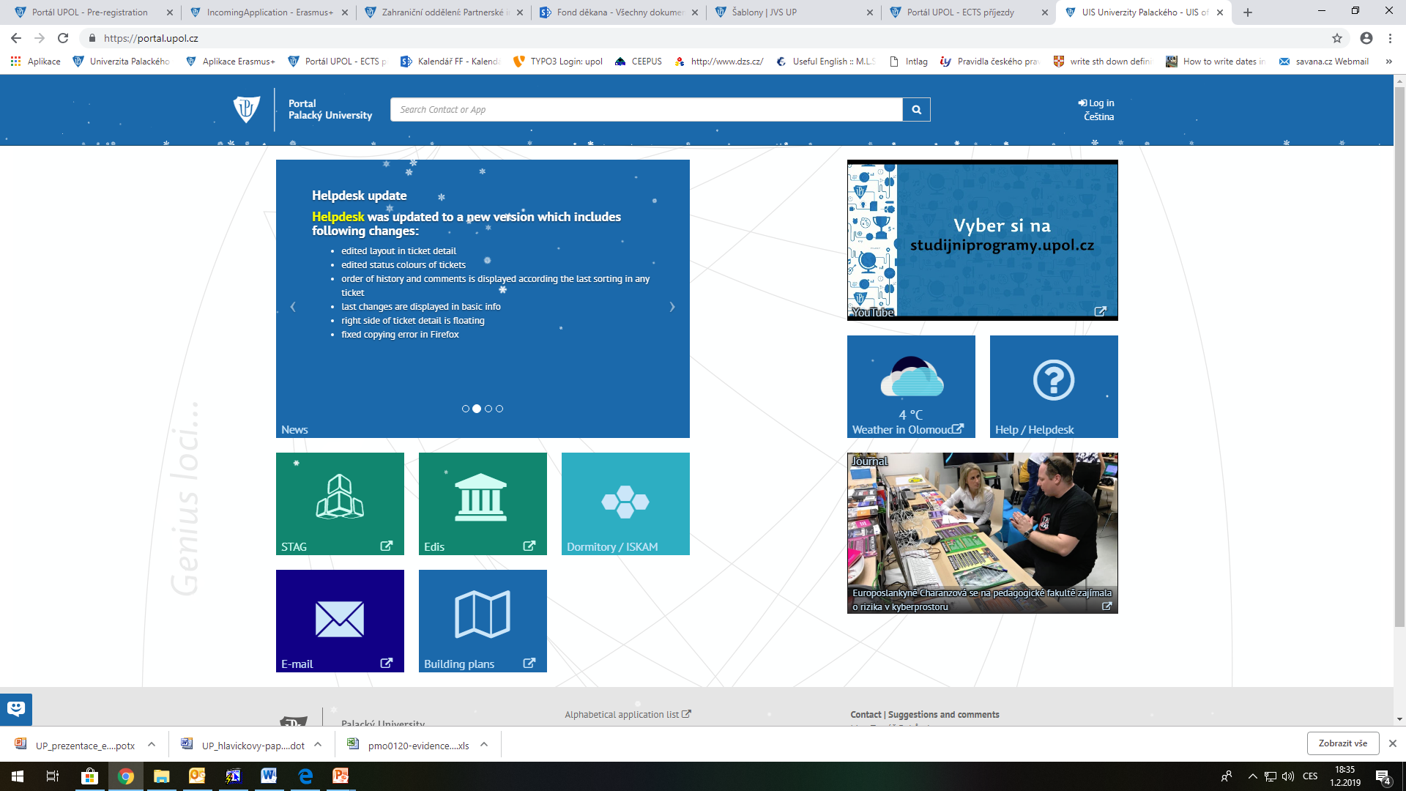
Palacký University Portal without login: https://portal.upol.cz/
na zkoušku

Slide 5
When you log into Palacký University Portal
click on STAG

Slide 6
Course enrolment (pre-registration)
The majority of registered courses has to be at the Faculty of Arts.
Each course is defined by an abbreviation, consist of department abbreviation (slide No. 7) and course code.
Enrolment possible in the Portal (login necessary), in STAG, My Study, section Pre-registration.
Course timetable appears with courses you are enroled in – see slide No. 8.
You should now be enroled in courses approved in your LA if such courses are opened this semester unless the capacity of a course is full (inform Simona Černá if you were not able to enrol in).

Slide 7
List of the departments – STAG abbreviations
Department of British and American Studies | KAA
Department of Applied Economy | KAE
Department of Applied Linguistics | KAL
Department of Asian Studies | ASH – Chinese Philology ASJ – Japanese Philology ASK – Korean Philology ASI – Indonesian Philology
Department of Czech Studies | KBH
Department of History of Arts | DVU
Department of Theatre, Film and Media Studies | KDU
Department of Philosophy | KFI
Department of German Studies | KGN
Department of History | KHI
Centre of Jewish Studies | JUD
Department of Musicology | MUZ
Department of Dutch Studies | NIZ
Department of General Linguistics | KOL
Department of Politics and European Studies | KPE
Department of Psychology | PCH
Department of Romance Languages | KRF – French Philology
 | KRI – Italian Philology
 | KRP – Portuguese Philology
 | KRS – Spanish Philology
Department of Slavonic Studies | KSO – Polish Philology
 | KSR – Russian Philology
 | KSU – Ukrainian Philology
Department of Sociology, Andragogy and Cultural Anthropology | KSA
Department of Journalism | KZU

Slide 8
Pre-registration, timetable

Slide 9
Course enrolment (pre-registration)
If you find out that two courses take place at the same time, you will have to decide which one you prefer and cancel the other one.
Important dates regarding course enrolment:
Pre-registration now opened (you can still enrol in courses which are not full)
Cancellation of a course in Stag possible between February 15 and February 20 (midnight)
To add a new course - enrolment open till February 22 (midnight)

Slide 10
Czech for Exchange Students
The course Czech for Foreigners is taught at the Department of Czech Studies and is intended for all exchange students.
The course includes two lessons (90 min.) per week and is divided into four levels: beginners, beginners+ (for students from Slavonic countries), intermediate and advanced. The code for enrollment of this course in STAG is CJPC1 (fall semester) and CJPC2 (spring semester). Students who regularly attend the course and pass the final test are given 4 ECTS points. Optionally, students can enroll an oral exam in Czech (code CJPZ1 and CJPZ2 for 1 ECTS point).
In case you are a beginner, you do not have to undertake the placement test. If your level of knowledge is higher, please take the placement test.
The timetable, placement test and other instruction: https://kb.upol.cz/czech-for-foreigners/

Slide 11
Courses primarily designed for exchange students
CJV/AEP- Academic English Presentation
CJV/ECEX - English Communication for Exchange Students
KAA/ERAS - Czech Culture and History
KPE/BCECS - Central European Culture and Society
KPE/BCEU - Central Europe and the European Union

Slide 12
The Department of Economic and Managerial Studies (KEMS)
Start of the spring semester 2020/21 - IMPORTANT
All foreign students who want to attend courses offered by KEMS (code KAE/ ..) must contact the teacher no later than 14 February (for email addresses, see the list of teachers at www.kae.upol.cz). The teacher will send students instruction regarding online teaching by email. Based on this announcement, such a student will be additionally registered for the course in ISI Stag.

Slide 13
Courses at another faculty
Our students sometimes take a course or a few at the Faculty of Education or Faculty of Law.
The course enrolment at a different faculty is not the same. If you are interested in a course offered by another faculty and you were not able to enrol in, check the availability of such course with a teacher.
In case you are enroled in a course and do not have the link to join the first lecture, contact the teacher before (couple of days) the semester starts!

Slide 14
In conclusion – important dates
Pre-registration at the Faculty of Arts:
Course enrolment cancellation possible till February 20 (midnight)
New course enrolment possible till February 22 (midnight)
Get to know your timetable and be sure you have links to join the lectures.
The timetable arises from the course pre-registration (STAG – My Study).
You have to be registered for all attended courses in STAG (My Study)
In case you are not, get in touch with Simona Černá, faculty coordinator

Slide 15
Contact details
Simona Černá, Incoming Students Coordinator
Křížkovského 10, Building C, room 2.20
email: simona.cerna(at)upol.cz
Phone: +420585633496
www: https://www.ff.upol.cz/en/exchange-students-and-guests/exchange-students/
Office hours:
Monday 10-11 a.m.
Tuesday 9-11 a.m.
Wednesday: 10-11 a.m., 1-3 p.m.
Thursday: 9-11 a.m.

